Slide 1
Data Structure and Algorithm
Course Code: CS-201
Topic: Sorting Techniques
Instructor: habiba arshad

Slide 2
CLO Covered
CLO3: Analyze empirically the behavior of algorithms in terms of time and memory used. GA3, C4

Slide 3
Sorting- Introduction
Sorting is used to arrange names and numbers in meaningful ways.
Let A be a list of n elements A1, A2, ....... An in memory.
Sorting of list A refers to the operation of rearranging the contents of A so that they are in increasing (or decreasing) order.

Slide 4
Sorting Techniques
Sorting can be performed in many ways.
Over a time several methods (or algorithms) are being developed to sort data(s).
Bubble sort,
Selection sort,
Quick sort,
Merge sort,
Heap sort
Binary sort,
Shell sort
Radix sort are the few sorting techniques

Slide 5
Bubble Sort
If N elements are given in memory then for sorting we do the following steps
First compare the 1st and 2nd element of array if 1st is greater than 2nd then compare 2nd with 3rd.
If 2nd >3rd then interchange the value of 2nd and 3rd
Now compare the value of 3rd(which has the value of 2nd) with 4th.
Similarly compare until the N-th element is compared with Nth element.
Now the highest value element is reached at the Nth place.
Now the elements will be compared until N-1 elements.

Slide 6
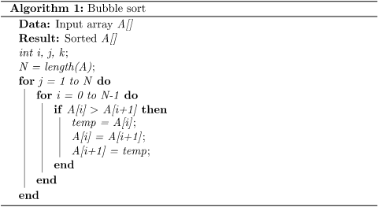
Bubble Sort

Slide 7
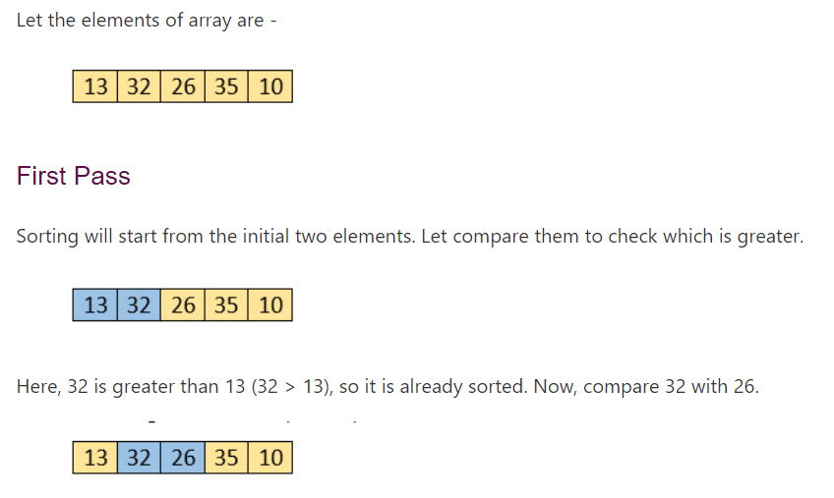
Bubble Sort

Slide 8
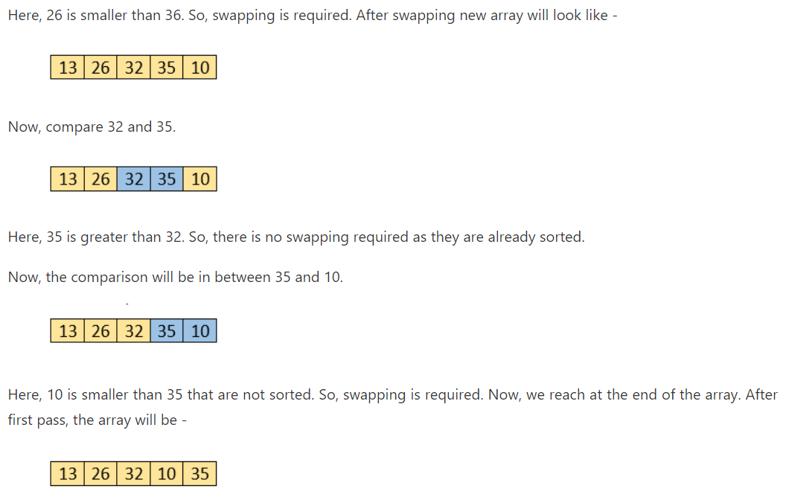
Bubble Sort

Slide 9
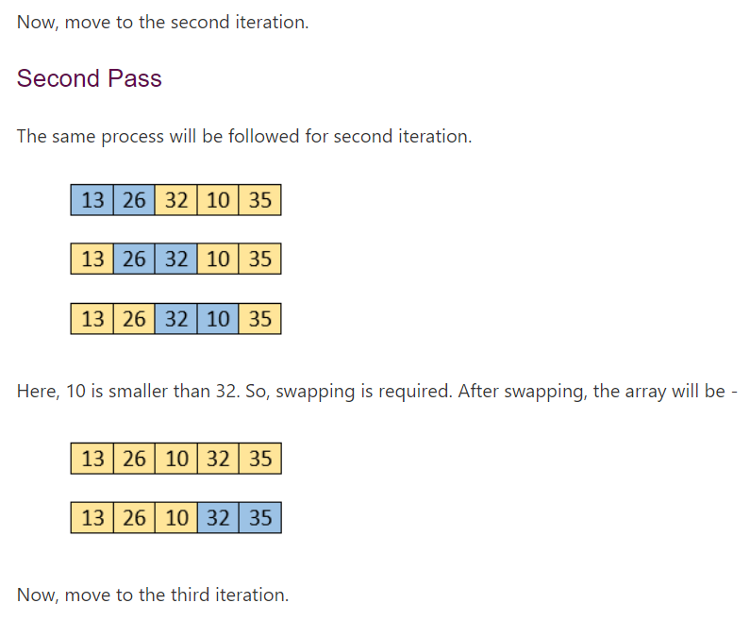
Bubble Sort

Slide 10
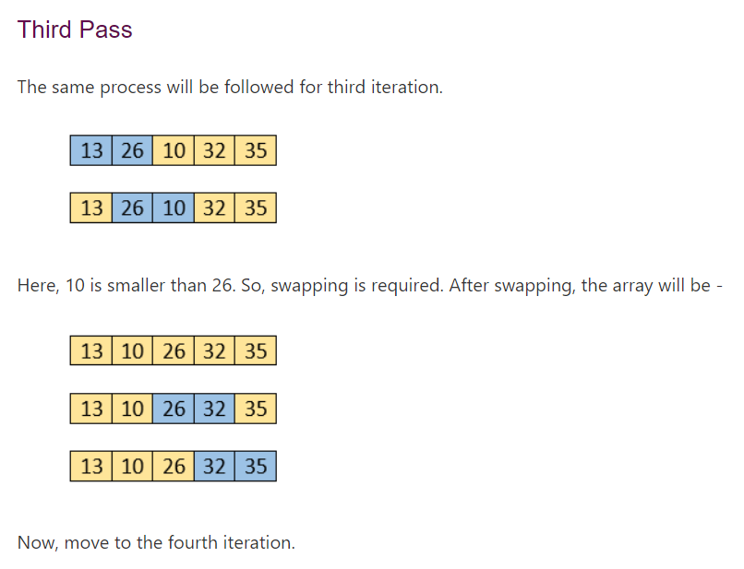
Bubble Sort

Slide 11
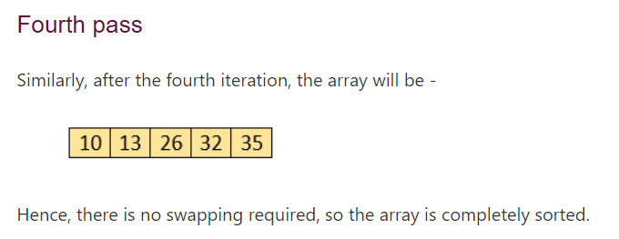
Bubble Sort
Time Complexity: O(N^2)

Slide 12
Selection Sort
In selection sort, the smallest value among the unsorted elements of the array is selected in every pass and inserted to its appropriate position into the array.
It is an in-place comparison sorting algorithm.

Slide 13
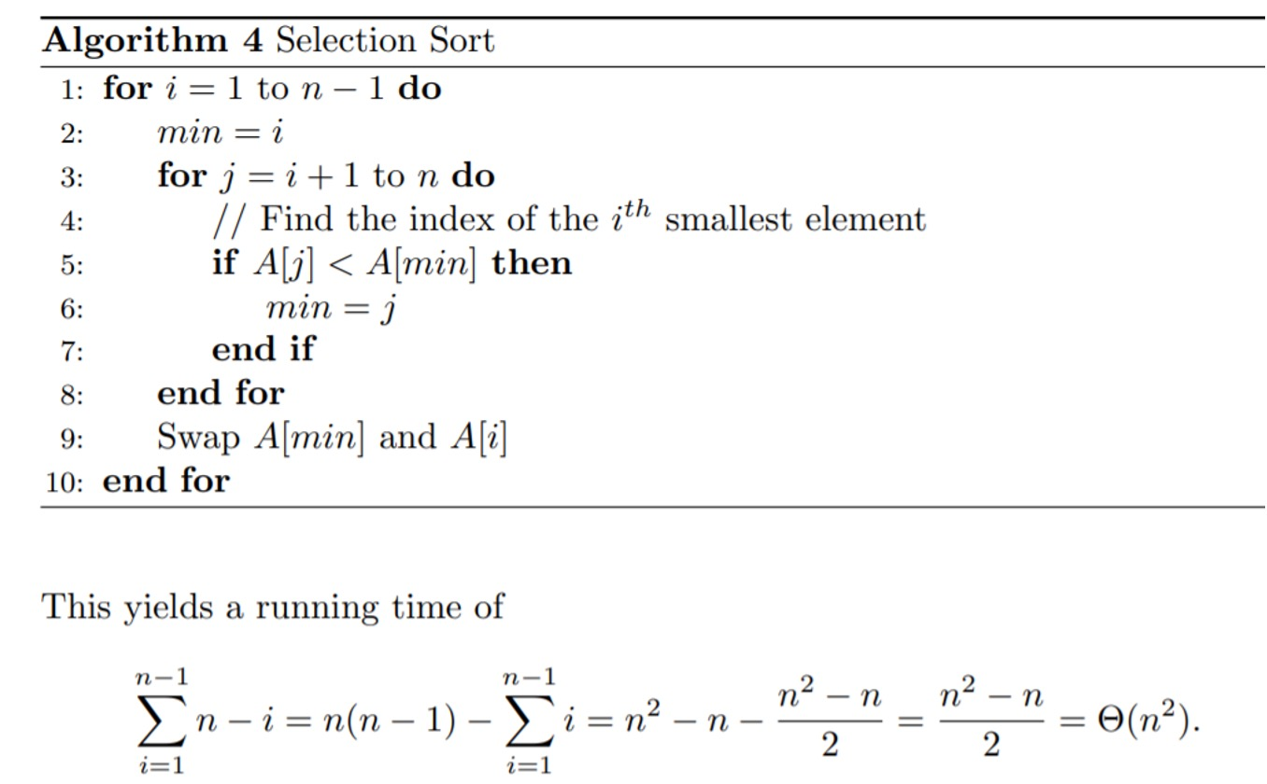

Slide 14
Selection Sort
Selection sort is generally used when -
A small array is to be sorted
Swapping cost doesn't matter
It is compulsory to check all elements

Slide 15
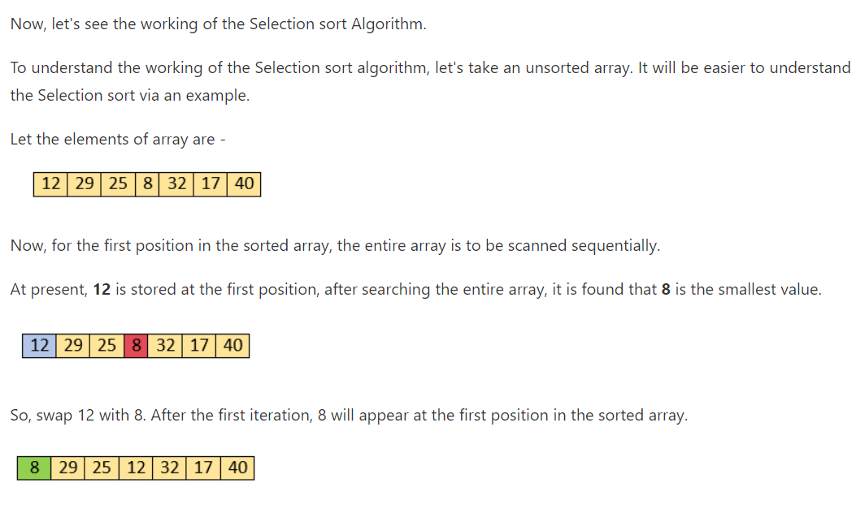
Working of Selection Sort

Slide 16
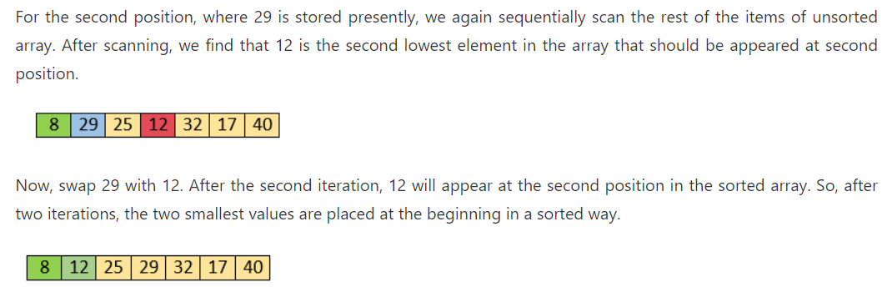
Working of Selection Sort

Slide 17
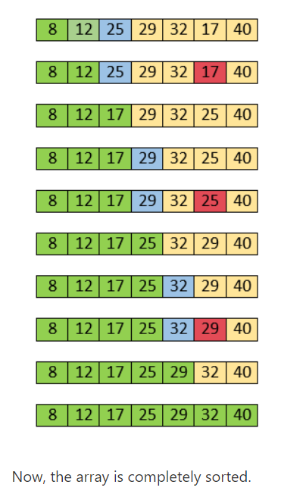
Working of Selection Sort

Slide 18
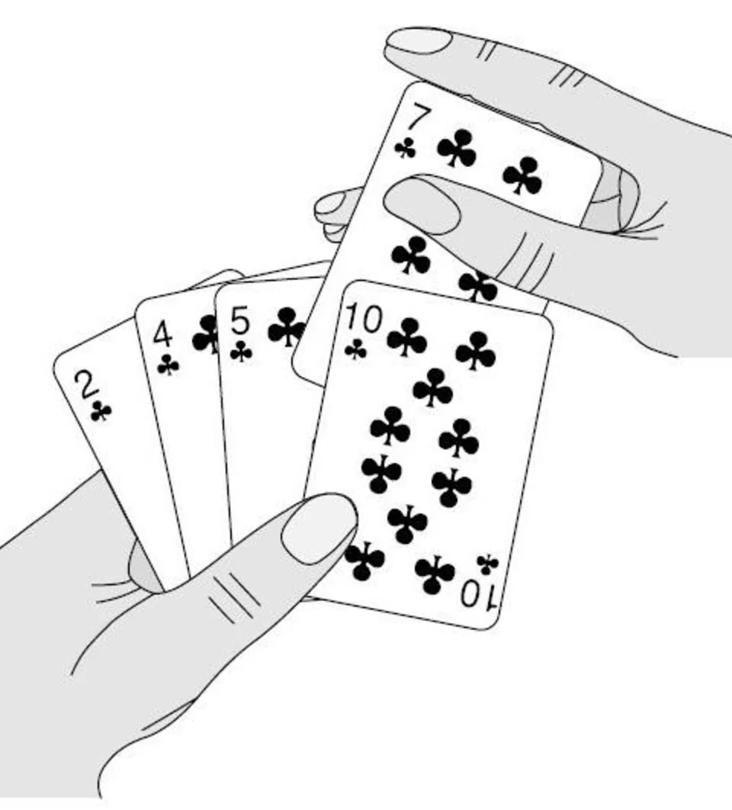
Insertion Sort
Insertion sort algorithm sorts a set of values by inserting values into proper place.
Works in the same way you organize cards.
You pick an unsorted card one at a time and insert it into its correct position in your hand.
It is assumed that the first card is already sorted in the card game, and then we select an unsorted card.
If the selected unsorted card is greater than the first card, it will be placed at the right side; otherwise, it will be placed at the left side.
Similarly, all unsorted cards are taken and put in their exact place.
The same approach is applied in insertion sort.

Slide 19
Working of insertion sort
Insertion sort splits an array into two sub-arrays.
The first sub-array is always sorted and gets larger as the sort continues.
The second sub-array gets smaller as the sort progresses.
When the sort first begins the first elements in the array is considered to sorted array.
With each iteration of the loop, the next value in the unsorted section is placed into its proper position in the sorted section.
This sorting procedure is efficient for smaller values

Slide 20
Insertion Sort
input array
5 2 4 6 1 3
at each iteration, the array is divided in two sub-arrays:
left sub-array
right sub-array
sorted
unsorted

Slide 21
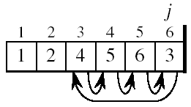
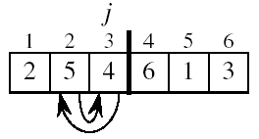
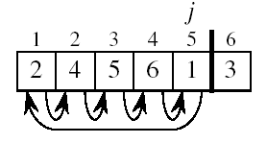
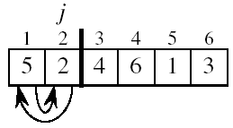
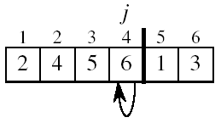
Insertion Sort

Slide 22
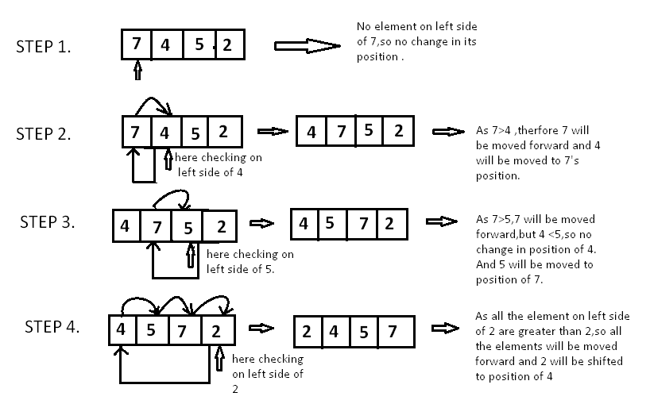
Insertion Sort

Slide 23
INSERTION-SORT
1
2
3
4
5
6
7
8
a₁
a₂
a₃
a₄
a₅
a₆
a₇
a₈
Alg.: INSERTION-SORT(A)
for j = 2 to n
do key =A[ j ]
Insert A[ j ] into the sorted sequence A[1 . . j -1]
i = j - 1
while i > 0 and A[i] > key
do A[i + 1] = A[i]
i = i – 1
A[i + 1] = key
Insertion sort – sorts the elements in place
key

Slide 24
Example (ascending order)
Original Array | 76 | 3 | 94 | 55 | 21 | 1
Iteration 1 | 76 | 3 | 94 | 55 | 21 | 1
Iteration 2 S0: Swap | 3 | 76 | 94 | 55 | 21 | 1
Iteration 3 | 3 | 76 | 94 | 55 | 21 | 1
94>55 Interchange | 3 | 76 | 94 | 55 | 21 | 1

Slide 25
Cont . . .
Iteration 4 S0:Swap | 3 | 76 | 55 | 94 | 21 | 1
55<76 True Swap | 3 | 55 | 76 | 94 | 21 | 1
55<3 No Leave | 3 | 55 | 76 | 94 | 21 | 1

Slide 26
Cont . . . .
Iteration 5 | 3 | 55 | 76 | 94 | 21 | 1
S0: True Swap | 3 | 55 | 76 | 21 | 94 | 1
21<76 True Swap | 3 | 55 | 21 | 76 | 94 | 1
21<55 True Swap | 3 | 21 | 55 | 76 | 94 | 1
21<3 No Leave | 3 | 21 | 55 | 76 | 94 | 1

Slide 27
Cont . . .
Iteration 6 | 3 | 21 | 55 | 76 | 94 | 1
S0: true Swap | 3 | 21 | 55 | 76 | 1 | 94
1<76 true Swap | 3 | 21 | 55 | 1 | 76 | 94
1<55 true Swap | 3 | 21 | 1 | 55 | 76 | 94
1<21 true Swap | 3 | 1 | 21 | 55 | 76 | 94
1<3 true Swap | 1 | 3 | 21 | 55 | 76 | 94
Sorted | 1 | 3 | 21 | 55 | 76 | 94

Slide 28
Cont . . .
Task :
Sort the following into descending order
Un Sorted Array | 7 | 5 | 2 | 4 | 3 | 9

Slide 29
Merging
If there are two sorted lists of array then process of combining these sorted lists into sorted order is called merging.
We can take this process with two approaches.
First one, take the first array, after that take second array and sort them with any sorting.
But it is not useful because both the lists are sorted and we are taking them as unsorted list.
The second approach is to take one element of each array, compare them and then take the smaller one in third array. Repeat this process until the elements of any array are finished. Then take the remaining elements of unfinished array in third array.

Slide 30
Merging
Merge.
Keep track of smallest element in each sorted half.
Insert smallest of two elements into auxiliary array.
Repeat until done.
smallest
smallest
A
G
L
O
R
H
I
M
S
T
A
auxiliary array

Slide 31
Merging
Merge.
Keep track of smallest element in each sorted half.
Insert smallest of two elements into auxiliary array.
Repeat until done.
smallest
smallest
A
G
L
O
R
H
I
M
S
T
A
G
auxiliary array

Slide 32
Merging
Merge.
Keep track of smallest element in each sorted half.
Insert smallest of two elements into auxiliary array.
Repeat until done.
smallest
smallest
A
G
L
O
R
H
I
M
S
T
A
G
H
auxiliary array

Slide 33
Merging
Merge.
Keep track of smallest element in each sorted half.
Insert smallest of two elements into auxiliary array.
Repeat until done.
smallest
smallest
A
G
L
O
R
H
I
M
S
T
A
G
H
I
auxiliary array

Slide 34
Merging
Merge.
Keep track of smallest element in each sorted half.
Insert smallest of two elements into auxiliary array.
Repeat until done.
smallest
smallest
A
G
L
O
R
H
I
M
S
T
A
G
H
I
L
auxiliary array

Slide 35
Merging
Merge.
Keep track of smallest element in each sorted half.
Insert smallest of two elements into auxiliary array.
Repeat until done.
smallest
smallest
A
G
L
O
R
H
I
M
S
T
A
G
H
I
L
M
auxiliary array

Slide 36
Merging
Merge.
Keep track of smallest element in each sorted half.
Insert smallest of two elements into auxiliary array.
Repeat until done.
smallest
smallest
A
G
L
O
R
H
I
M
S
T
A
G
H
I
L
M
O
auxiliary array

Slide 37
Merging
Merge.
Keep track of smallest element in each sorted half.
Insert smallest of two elements into auxiliary array.
Repeat until done.
smallest
smallest
A
G
L
O
R
H
I
M
S
T
A
G
H
I
L
M
O
R
auxiliary array

Slide 38
Merging
Merge.
Keep track of smallest element in each sorted half.
Insert smallest of two elements into auxiliary array.
Repeat until done.
first half exhausted
smallest
A
G
L
O
R
H
I
M
S
T
A
G
H
I
L
M
O
R
S
auxiliary array

Slide 39
Merging
Merge.
Keep track of smallest element in each sorted half.
Insert smallest of two elements into auxiliary array.
Repeat until done.
first half exhausted
smallest
A
G
L
O
R
H
I
M
S
T
A
G
H
I
L
M
O
R
S
T
auxiliary array

Slide 40
Merge Sort
In second approach of merging, we can take the pair of consecutive array elements, merge them in sorted array and then take adjacent pair of array elements and so on until the all elements of array are in single list.

Slide 41
Merge Sort
Based on divide and conquer strategy
List is divided into two halves (Divide)
Each half is sorted independently (Conquer)
Two halves are merged into a sorted sequence.

Slide 42
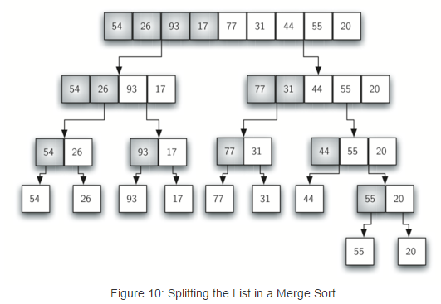
Merge sort Algorithm

Slide 43
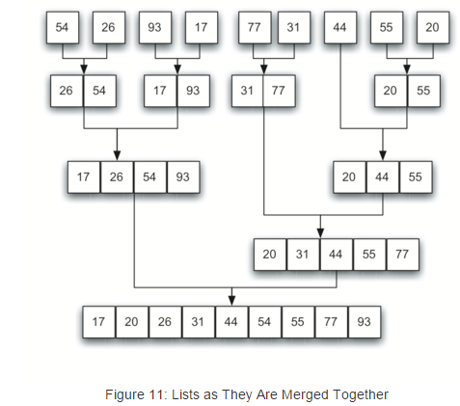
Merge sort Algorithm

Slide 44
Merge Sort
Step 1 − if it is only one element in the list it is already sorted, return.
Step 2 − divide the list recursively into two halves until it can no more be divided.
Step 3 − merge the smaller lists into new list in sorted order.

Slide 45
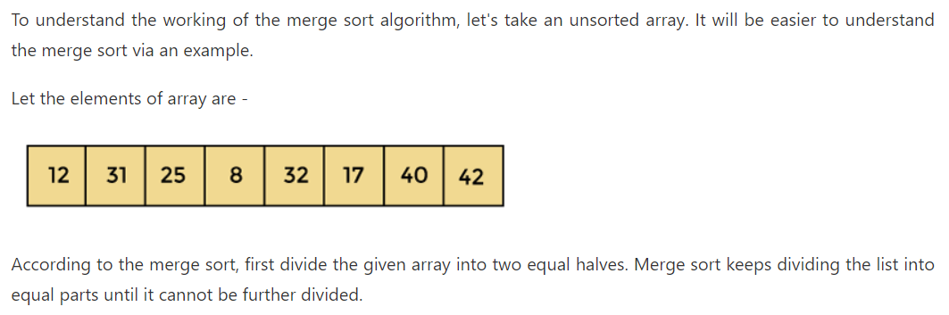
Working of Merge sort

Slide 46
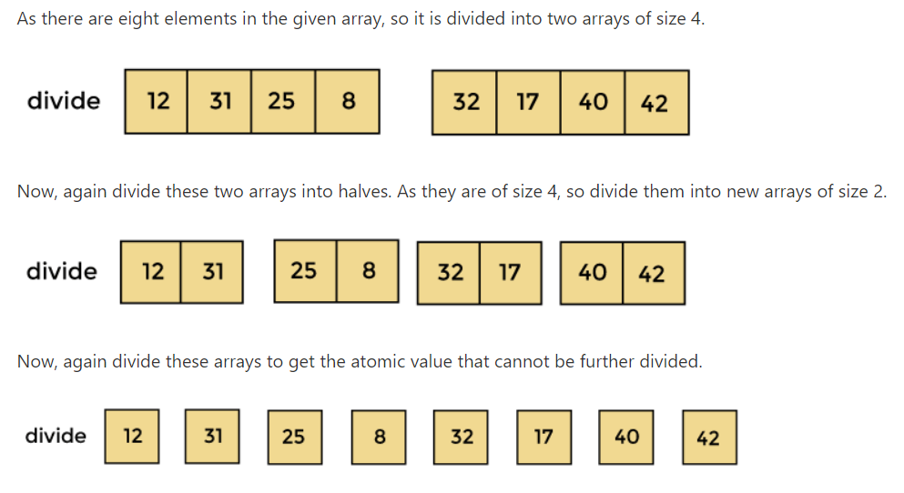
Working of Merge sort

Slide 47
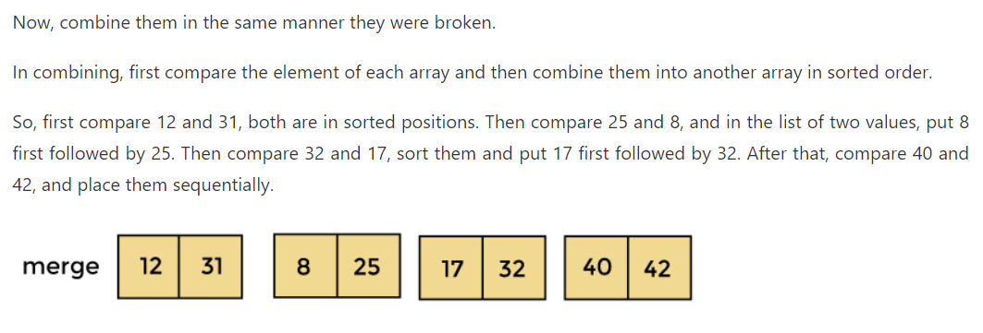
Working of Merge sort

Slide 48
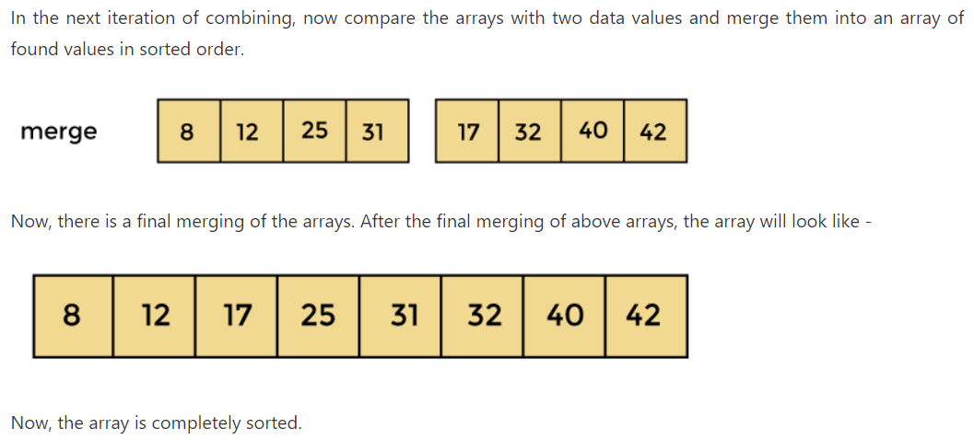
Working of Merge sort

Slide 49
Time and Space Complexity
Time complexity of Merge Sort is O(n*Log n) in all the 3 cases (worst, average and best) as merge sort always divides the array in two halves and takes linear time to merge two halves.
It requires equal amount of additional space as the unsorted array as O(n). Hence its not at all recommended for searching large unsorted arrays.

